Slide 1
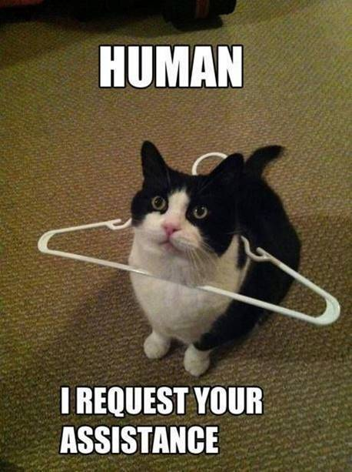
Timeline
Orals
Grammar: Beschrijven
Work from the book
Goal: being able to give a discription
of people, things and actions.
Notes:
Afbeelding: https://www.flickr.com/photos/studiodxavier/6063335422

Slide 2
Oral exams DV21A
Planning oral exams
Week Date Name
3 - -
4 15-12 Arjan, Huub, Yessie
5 21-12 Amir, Luuk, Arjan
6 12-01 TEST VOCAB + GRAMMAR UNIT 2
7 19-01 Amir, Indy, Sem, Paola
8 24/25-01 Sem, Rik, Britt, Rens, Zenja
9 1-02 Rochelle, Meyke, Myrthe, Anouk, Femke
10 8/9-02 Luuk, TEST VOCAB + GRAMMAR UNIT 3 + LISTENING

Slide 3
Grammar – Bijvoeglijk naamwoord en Bijwoord
Make assignment A on your worksheet.
We will check the answers together in 5 minutes.
Maak opdracht A op je werkblad.
We controleren de antwoorden over 5 minuten.

Slide 4
Grammar – Bijvoeglijk naamwoord en Bijwoord
Now you. Circle the correct word in these sentences.
We will check the answers in 5 minutes.
She sang beautiful/ beautifully.
I asked him polite/ politely.
He is a careful/ carefully man.
These nice/ nicely girls shared their food with that guy.
You have to come home immediate/ immediately.

Slide 5
Grammar – Bijvoeglijk naamwoord en Bijwoord
Now you. Circle the correct word in these sentences.
We will check the answers in 5 minutes.
She sang beautiful/ beautifully.
I asked him polite/ politely.
He is a careful/ carefully man.
These nice/ nicely girls shared their food with that guy.
You have to come home immediate/ immediately.

Slide 6
Grammar – Bijvoeglijk naamwoord en Bijwoord
Now you. Circle the correct word in these sentences.
We will check the answers in 5 minutes.
She sang beautiful/ beautifully.
I asked him polite/ politely.
He is a careful/ carefully man.
These nice/ nicely girls shared their food with that guy.
You have to come home immediate/ immediately.

Slide 7
Grammar – Bijvoeglijk naamwoord en Bijwoord
Now you. Circle the correct word in these sentences.
We will check the answers in 5 minutes.
She sang beautiful/ beautifully.
I asked him polite/ politely.
He is a careful/ carefully man.
These nice/ nicely girls shared their food with that guy.
You have to come home immediate/ immediately.

Slide 8
Grammar – Bijvoeglijk naamwoord en Bijwoord
Now you. Circle the correct word in these sentences.
We will check the answers in 5 minutes.
She sang beautiful/ beautifully.
I asked him polite/ politely.
He is a careful/ carefully man.
These nice/ nicely girls shared their food with that guy.
You have to come home immediate/ immediately.
If you’ve made NO mistakes you can skip my explanation and work from the book.

Slide 9
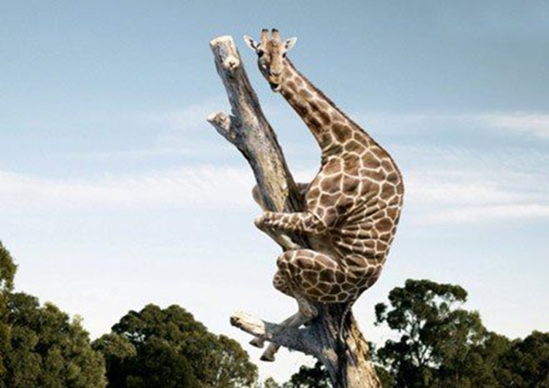
Grammar – Beschrijven
Fearful
Timmy is a fearful giraffe.
He holds on to the tree fearfully.

Slide 10
Grammar – Beschrijven
Fearful
Timmy is a fearful giraffe.
He holds on to the tree fearfully.
Iets of iemand
Actie

Slide 11
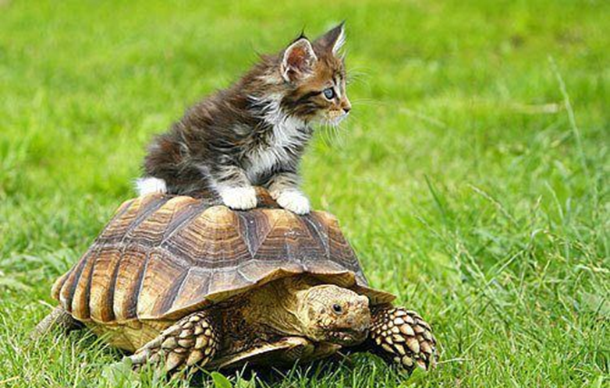
Slow
Thom is a ________ turtle.
He walks home _________.
Iets of iemand
Actie

Slide 12
Slow
Thom is a __slow__ turtle.
He walks home __slowly____.
Iets of iemand
Actie

Slide 13
Grammar – Beschrijven
Bijvoegelijke naamwoorden (Adjectives) en Bijwoorden (Adverbs)
Zelfstandig naamwoord
= woorden waar je de, het of een voor kunt zetten
= woorden waar je a of an voor kunt zetten in het Engels
 | When Zegt iets over… | Rule | Signaalwoord
Bijvoeglijk naamwoord | Iets of iemand | Woord | Zelfstandig naamwoord
Bijwoord | Actie | Woord + ly | Werkwoord

Slide 14
Grammar – Beschrijven
Now finish assignments B and C.
You get 10 minutes to finish the assignments
You can discuss with your neighbour
We check the answers in class

Slide 15
Grammar – Beschrijven
B. Look at the first word at the start of each sentence. Fill in the correct form of the word in the gap of both sentences.
Careful Timmy is a careful giraffe.
He climbed up the ladder carefully.
Angry The dog is angry.
It barks angrily .
Excellent He acted excellently.
He's an excellent actor.
Easy They learn English easily.
They think English is an easy language.
Good Laura is a good singer.
She sings well.

Slide 16
Grammar – Beschrijven
C. Look at the first word at the start of each sentence. Fill in the correct form of the word in the gap.
1. Beautiful She is a beautiful girl.
2. Fantastic We look fantastic.
3. Ridiculous She talks ridiculously.
4. Soft Her voice is soft.
5. Wonderful David cooks wonderfully.
6. Good This is a good movie.
7. Fast The Fast and the Furious is about fast cars.
8. Good I can speak English very well.
9. Fantastic She dresses fantastically.
10. Happy The children play happily.

Slide 17
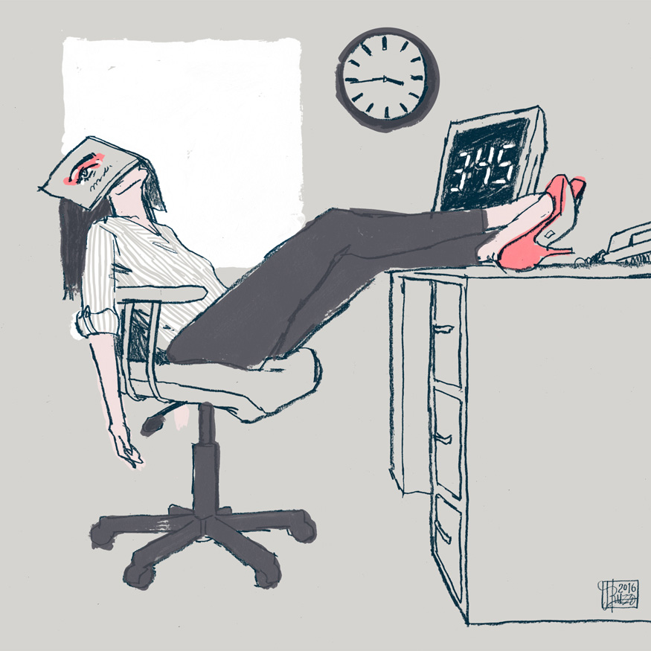
Work on your own

